Slide 1
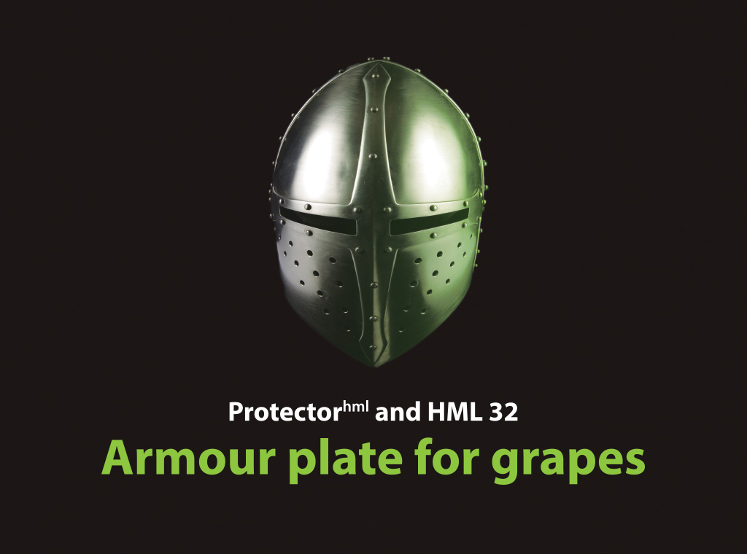

Slide 2
Purpose of Study
To identify the best timing/s and rates to give a successful improvement of maturity on heavy cropped red grapes without causing unacceptable phyto-toxicity or desiccation.

Slide 3
Summary of Presentation
‘What we are going to talk about’
Previous examples of enhanced maturity
Vineyard background, trial layout and application (water rates, dates and sprayer audit)
Four parameters to ensure a favourable outcome
Brix accumulation
Juice values of trial wines
Sensory values from free run juices
Finished wine values (winery)
Comparison of potassium levels juices vs wines
Tannin analysis and comparison
Total Phenolic comparison
Total Pigment comparison
Free Anthocyanin comparison
Winemakers comments
Winemakers rankings
Our conclusion

Slide 4
Sileni Sauvignon Blanc 2011

Slide 5
Monowai Chardonnay 2013

Slide 6
Vineyard Background
Location: The Te Awa Vineyard is Villa Maria owned, located at 2375 State Highway 50, Hastings, Hawkes Bay, New Zealand - on the edge of the Gimblett Gravels.
Variety, Density and Trellising: The vines were grafted Merlot, perhaps 15 years old, well-tended and irrigated. The row width was 2.4m and the distance between plants 1.8m. Trellising is 4 cane VSP, but many vines were 3 caned for crop reduction.
Cropping History: The trial area cropped at 13.8t/ha after being manually crop thinned. Unchecked the block has previously produced 20t/ha, history of being slow to mature. This block again was one of the last Merlot to be harvested this season because of slow maturity.
Bunch Exposure: The fruit zone on the lower cordon was well leaf plucked, giving high bunch exposure, the upper cordon in the region of 70%.
Disease control: Very low levels of powdery mildew and botrytis were present during the trial period. The block had been treated with conventional fungicides (no use of HML32) up to veraison.

Slide 7
Treatments
HML32 – 1% Protector plus 300 g Potassium Bicarbonate per 100 litres of water
HML20 – 1% Protector plus 200 g Potassium Bicarbonate per 100 litres of water
HML15 – 1% Protector plus 150 g Potassium Bicarbonate per 100 litres of water
HML10 – 1% Protector plus 100 g Potassium Bicarbonate per 100 litres of water

Slide 8
Treatment and Timing Layout
No. of Rows | 6 bays per row | 6 bays per row | 6 bays per row | 6 bays per row | Treatment code
2 | 40 day alone | 40day/30day | 40day/20day | 40day/10day | HML32
2 | 10day alone | 30day alone | 30day/20day | 30day/10day
2 | 20day/10day | 20 day alone | 20day alone | 20day/10day
2 | 30day/10day | 30day/20day | 30day alone | 10day alone
2 | 40day/10day | 40day/20day | 40day/30day | 40day alone | HML20
2 | 40 day alone | 40day/30day | 40day/20day | 40day/10day | HMl15
2 | 10day alone | 30day alone | 30day/20day | 30day/10day
2 | 20day/10day | 20 day alone | 20day alone | 20day/10day
2 | 30day/10day | 30day/20day | 30day alone | 10day alone
2 | 40day/10day | 40day/20day | 40day/30day | 40day alone | HML10

Slide 9
Application and water rates
All treatments were machine sprayed using a Silvan G2 fitted with a Farmscan controller.
The forward speed was 4.8km/hr and output 380l/ha on 2.4m rows, at the fruit zone. All treatments were reverse passed and therefore received 760l/ha. The sprayer was set up with 4 nozzles with higher air flow and spray output from the middle two.
The methodology was based on experience gained in applications made to eradicate powdery mildew infection. The regime is the first step to ensure adequate coverage – and will be improved over time

Slide 10
Application dates
Application 1: 2 March 2014 (35 days before harvest)
Application 2: 12 March 2014 (25 days before harvest)
Application 3: 24 March 2014 (13 days before harvest)
Application 4: 2 April 2014 (4 days before harvest)
Harvest: 6 April 2014
Intention and Reality
The intention was to begin the trial at 14 brix – but began at a block average of 15.5 brix.
40 days before harvest became 35 days before harvest due to a major rain event.

Slide 11
Four Parameters to ensure a favourable outcome
Potassium bicarbonate rates set conservatively, and formulated with the same rate of Protector^{hml} as occurs in HML32
Effective spray deposition ensured (sprayer audit, water rates, reverse passing).
Comprehensive brix, t/a and pH analyses undertaken on all treatments - pre-application and thereafter every 7 days until harvest.
As a precaution, the treatments were applied on grapes not previously sprayed with Protector or HML32 – however a major study in 2012/2013 proved previous applications had no effect on maturity outcomes.

Slide 12
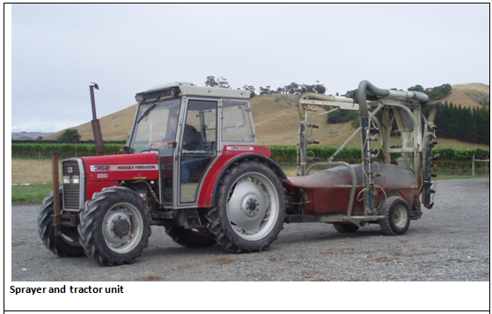
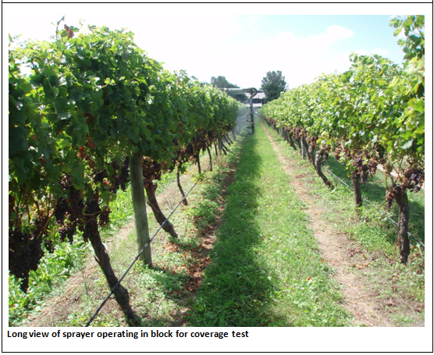
Sprayer
Audit
David Manktelow
Notes:
These slides are about the importance of application – as important as the product.
Audited sprayers – there are only limited people who possess the skills
We try to make trialling real – we use our own controlled sprayer to make results in trials more readily transferrable

Slide 13
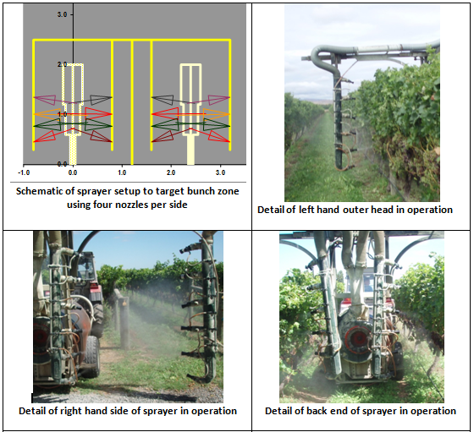
Sprayer setup visualisation

Slide 14
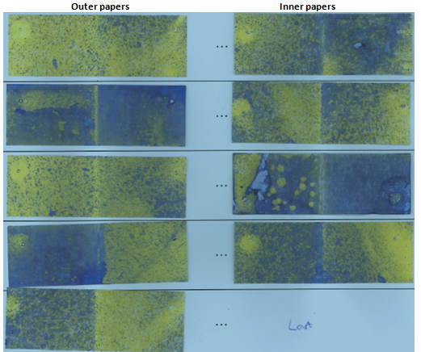
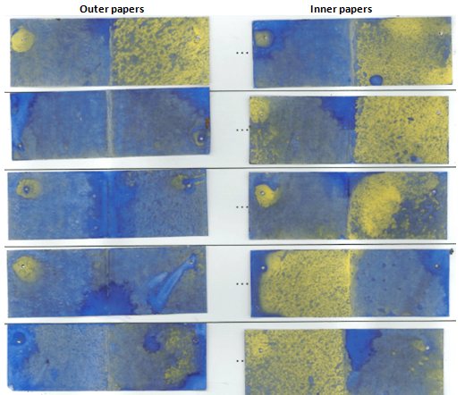
Single pass Double pass
Judgement: Good droplet size (fines) giving excellent coverage on all
paper surfaces. Runoff evident on 40-50% of surfaces.
Good coverage observed in bunches with some wetting to runoff,
but obscured back sides of bunches showing low deposits.
Judgement: Excellent coverage on all paper surfaces with visibly
increased deposits and deposit evenness on bunches compared
with a single pass. Runoff evident on 75% of surfaces.
Notes:
Application again.
This was done for enhancing maturity trials – but the same methodology is used for eradication.
All on the website – do it once, do it early and do it well.

Slide 15
Results through to harvest
Only HML32 treatments resulted in lasting and significant enhancement of maturity
Raisoning was slight, in keeping with New Zealand growing traditions. No observable or significant differences between the treatments in terms of raisoning , colour, shanking (end of bunch necrosis), or disease.
Yield variation between treatments was not measured.
Skin thickening occurred more on early applications regardless of rate, but this was not measured.

Slide 16
HML32 treatments
Brix Accumulation over time

Slide 17
HML32 Treatments
Juice Values received at Winery
Timing | Brix | pH | T/A
Control | 21.1 | 3.31 | 7.15
20 | 21.3 | 3.37 | 6.9
30/20 | 21.9 | 3.38 | 6.95
40/20 | 21.5 | 3.41 | 6.95
40/30 | 22.8 | 3.32 | 6.7

Slide 18
HML32 Treatments
Juice Analysis – Colour - Sensory
Control Lightest colour, slightly browning.
20 Second lightest colour, brick red
30/20 Vibrant pale pink
40/20 Vibrant pale pink, slightly browning
40/30 Vibrant deepish cranberry red

Slide 19
HML32 Treatments
Juice Analysis – Nose - Sensory
Control Slightly herbal with a musty character. Porty also.
20 Bright fruity, strawberry etc. Clean.
30/20 Bright and fruity with a good density. Clean.
40/20 Bright with good density. Clean.
40/30 Dense, mineral/ steel, quite closed but very concentrated.

Slide 20
HML32 Treatments
Juice Analysis – Palate - Sensory
Control High acid/ tannin, musty.
20 Clean with a soft acid/ tannin profile.
30/20 Clean, bright with a soft and fruity palate profile. Well balanced.
40/20 Clean, bright with a soft and fruit palate profile.
40/30 Concentrated with a supple front palate tannin profile. Most preferred.

Slide 21
HML32 Treatments
Finished Wine Analysis

Slide 22
Finished Wine Analysis

Slide 23
HML32 Treatments
Juice/Wine Analysis

Slide 24
HML32 Treatments
Wine Analysis - Tannins

Slide 25
HML32 Treatments
Wine Analysis -Total Phenolics

Slide 26
HML32 Treatments
Wine Analysis - Total Pigments

Slide 27
HML32 Treatments
Wine Analysis - Free Anthocyanins

Slide 28
Winemaker’s Rankings
1 most preferred - 5 least preferred
Application (days before harvest) | Control Untreated | 20 | 30/20 | 40/20 | 40/30
Ant MacKenzie | 3 | 2 | 4 | 5 | 1
Gordon Russell | 4 | 2 | 3 | 5 | 1
Miles Dinneen | 2 | 3 | 4 | 5 | 1
Paul Mooney | 3 | 2 | 5 | 4 | 1
Tony Bish | 4 | 2 | 3 | 5 | 1

Slide 29
Winemakers Tasting Notes
Description | Control |  | 40/30
Ant MacKenzie) | 3 | Vibrant colour, simple, fruity, clean, simple frontal tannin, OK | 1 | Deepest colour, plummy, brooding, most tannin, blueberry flavours, good
Gordon Russell | 4 | Light, bright, youthful, red, tobacco, drying tannins, mid weight, slight herbal, cherry stone, drying tannins, lacks charm | 1 | Deepest of flight, acceptable merlot colour & density, dark fruits, fruitcake, slightly herbal note, soft, rich, commercial quality, jammy, long
Miles Dinneen | 2 | Light colour, some purple, slight ? nose, light soft gentle/dilute, slight malty finish | 1 | Darker, only proper red wine colour, nice sweet fruit – slightly spiky acid/tannin in mid palate, bitter tannin/concentration, mid weight wine
Paul Mooney | 3 | Mid colour, attractive fruity nose, red berry spectrum, soft light tannins, light fruit weight, finish moderately long | 1 | Darkest colour, riper red – dark berry notes. Some complexity showing more structure that previous, more tannin on finish
Tony Bish | 4 | Light colour, similar to (30/20), Strawberry vanilla nose, hints raspberry, brambly palate, raspberry, more weight than (40/20) | 1 | Deepest colour quite significantly. Darker berry and ripe black plum notes. Good depth, riper, plusher, more weight

Slide 30
Conclusions
The trial was successful in enhancing the maturity of heavily cropped Merlot with no detrimental field effects, including increased rots – except a small likely reduction in yield.
Applications closer to veraison are more effective than those closer to harvest.
There were no significant differences in winemaking processes, and no faults produced.
Strong indications of improvements in overall wine quality.

Slide 31
Acknowledgements
The assistance given by Villa Maria was a very important part of this trial – not only did they take the crop risk, but they supplied the tractor used for spraying - in particular, thanks must go to Jonathan Hamlet who managed this block and coordinated the pre-treatments -also to Ollie Powrie and John Van de Linden for their on-going support.
On the sampling side particular thanks to Susan Mains who put aside much to assist with the weekly uplifting and analysis of a myriad of samples – also to Ant MacKenzie for his earlier tastings and comments.
Lastly is acknowledgement of Peter Wood, a scientist at Plant and Food Research. Although not up to his neck in this trial, his sage advice and assistance with data ensured an outcome that had some sort of scientific credibility.

